Slide 1
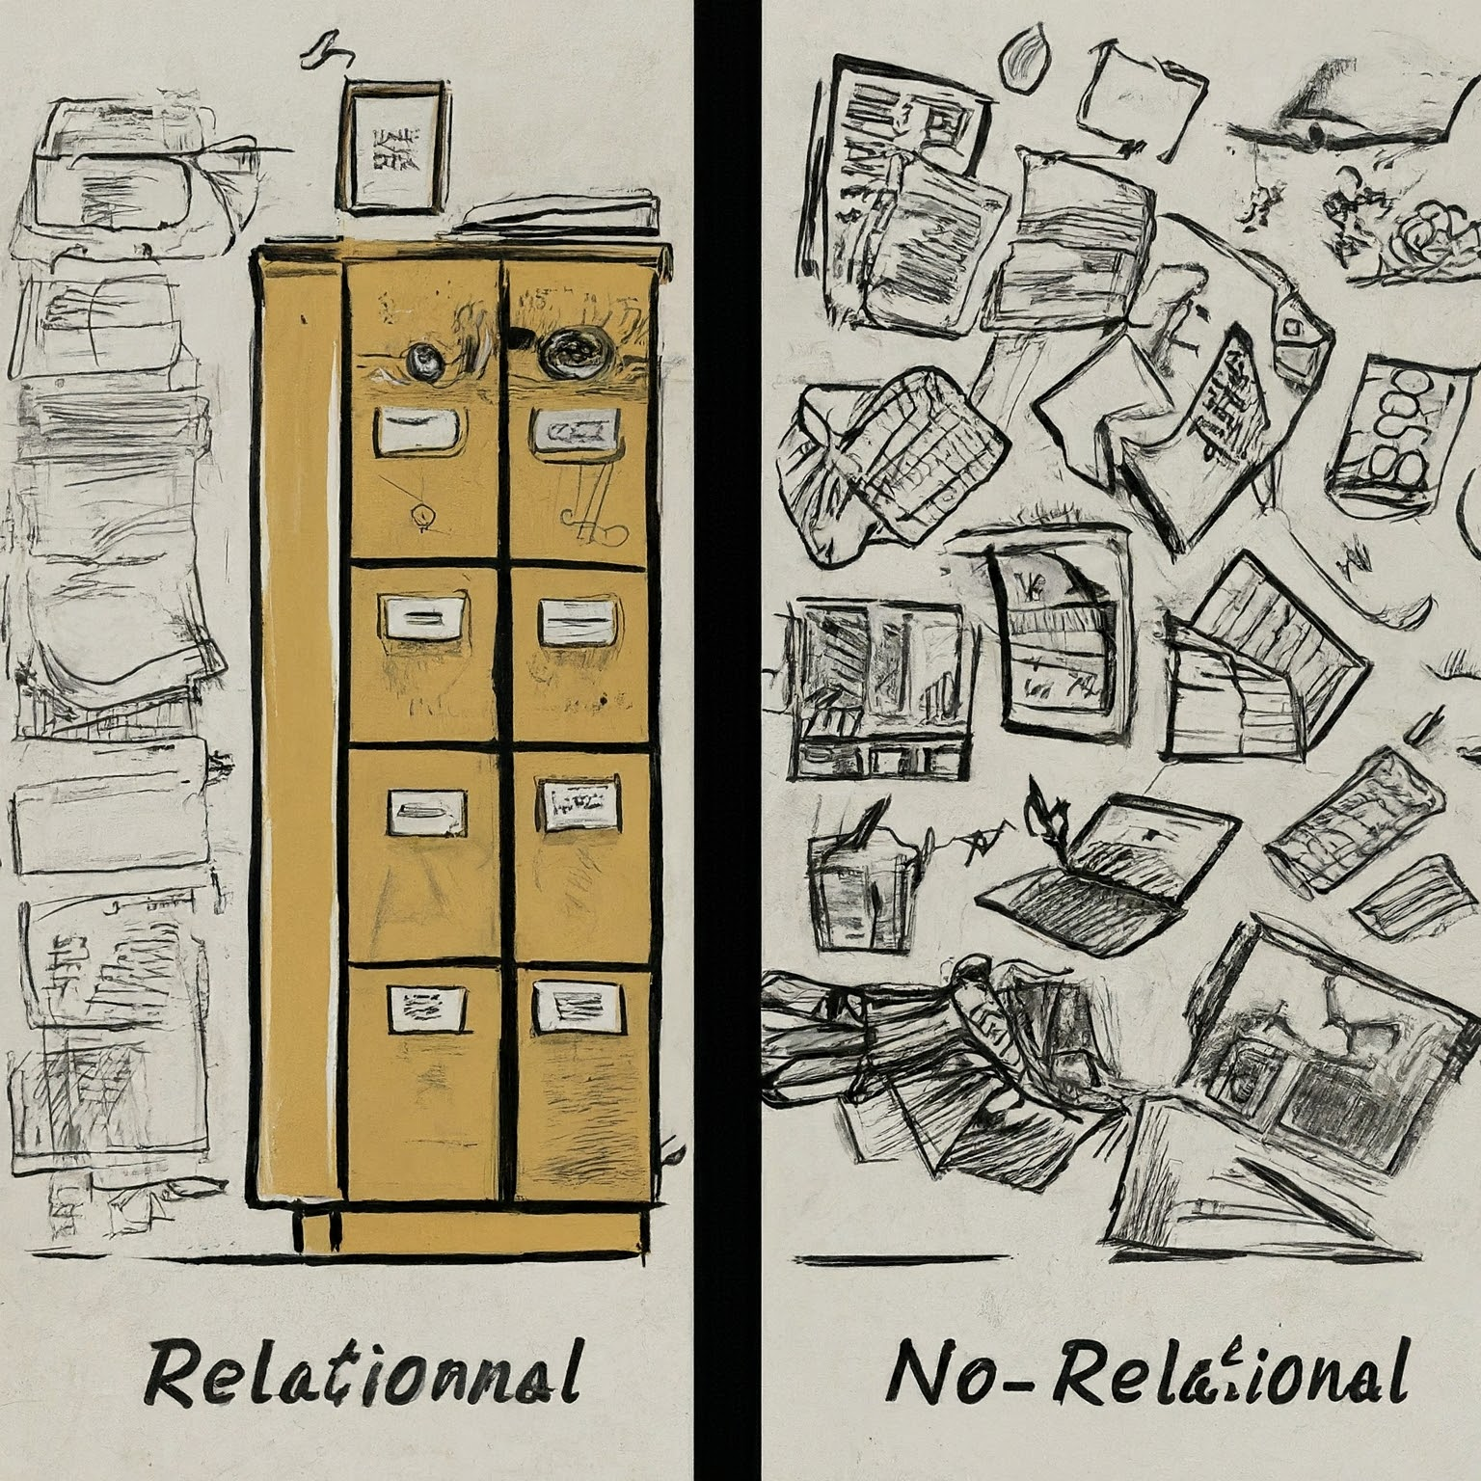
Relational Non-Relational Databases Understanding The Differences, Use Cases, And Advantages
VS
Presenter: Romeo Dandison

Slide 2
Table of contents
Introduction
Relational database
01
02
Non-Relational database
Comparison
03
04
Concept of database explained
Overview of relational databases
Overview of non-relational databases
Relational vs Non-Relational

Slide 3
Table of contents
Conclusion
References
05
07

Slide 4
01
Introduction
Concept of Databases

Slide 5
What are Database?
Database is a collection of data that is stored and organized in a specific way, allowing for efficient retrival and manipulation of the information. There are two types of databases; Relational often called (SQL) and Non-Relational (often called NoSQL).

Slide 6
02
Relational Database
Overview of relational Database

Slide 7
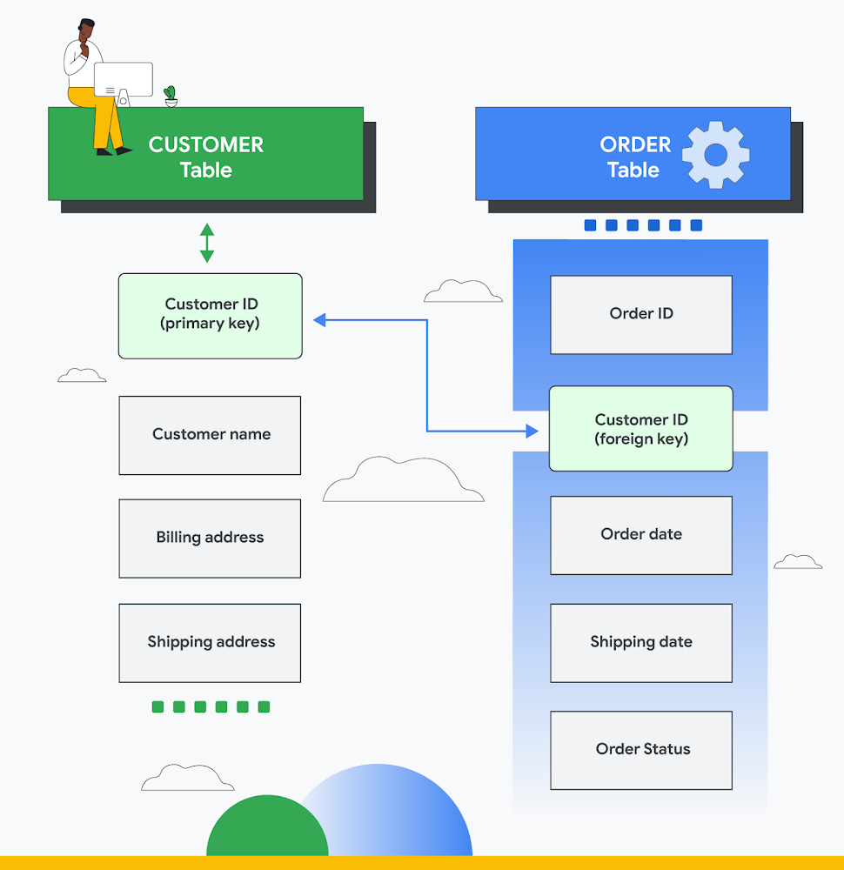
Overview of Relational Database
This type of databases stores data in form of tables; each table consists of rows (records or tuples) and columns (fields or attributes).
Examples of Relational Databases includes;
MySQL
PostgreSQL
Oracle Database
Microsoft SQL server

Slide 8
Advantages of Relational Databases
Data organization
No data redundancy
Data integrity and consistency
High level of data integration, due to relationships and constraints among tables
Data security
Data recovery
Interoperability between computers and software's.

Slide 9
Disadvantages of Relational Databases
Up-front schema definition
No adaptation to changing requirements: dynamic changes to an item affect all the other items in the same table
Data processing may be slow. High performance is possible with expensive hardware

Slide 10
03
Non-Relational Databases
Overview of Non-relational Databases

Slide 11
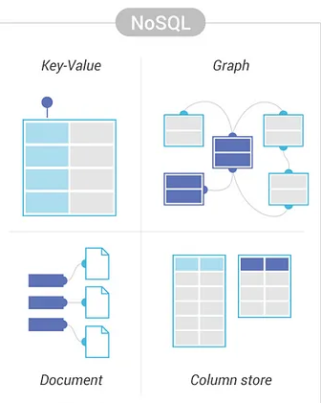
Overview of Non-Relational Databases
Non-relational databases, also known as NoSQL (Not Only SQL) databases, are designed to store, retrieve, and manage data that doesn’t fit neatly into the traditional table structure of relational databases. Unlike relational databases, which use a fixed schema and organize data into rows and columns, non-relational databases do not require a fixed schema, allowing data to be stored in various formats such as documents, key-value pairs, columns, or graphs. This flexibility is ideal for handling unstructured or semi-structured data.

Slide 12
Advantages of Non-Relational Databases
Flexible data model
Rapid adaptation to changing requirements: dynamic changes to an item do not affect the other items
Storage of huge amount of data with little structure.
High performance

Slide 13
Disadvantages of Non-Relational Databases
Low reliability
Manual query language
It is difficult to verify data integrity and consistency

Slide 14
Examples of Non-Relational Databases
Aerospike, Apache Cassandra, Berkeley DB, Couchbase Server, and Redis. They are often used for session data (where session_id is the key). For key-value stores
The most notable document databases include MongoDB and CouchDB.
HBase, Cassandra, Hypertable are NoSQL query examples of column based database.
Neo4J, Infinite Graph, OrientDB, FlockDB are some popular graph-based databases.

Slide 15
04
SQL vs NoSQL
Comparison

Slide 16
SQL vs NoSQL comparison table
 | SQL Database | NoSQL Databases
Type | Relational database | Non-relational database
Structure | Organize and store data by tables with fixed columns and rows | Data can be stored as graph, document –oriented, key-value, column-oriented & others
Schema | Fixed | Dynamic
Scalability | Follow a vertical approach | Scale horizontally

Slide 17
SQL vs NoSQL comparison table
 | SQL Database | NoSQL Databases
Query | SQL is typically the query language | Queries are dependent on the database in question; no declarative query language
Database Transaction | ACID compliance | BASE model is followed
Priority | Data integrity, consistency and stability | Flexibility, fast queries and scalability

Slide 18
Conclusion
Choosing the proper database is not a straight and precise decision, even for experts. Deciding whether to go for relational or non-relational databases is a great way to start.
For instance, for a lot of unstructured data, CouchDB or MongoDB can be a good option, but maybe for high-availability, Redis and Cassandra might be more suitable. And these are all non-relational database systems!
On the other hand, SQL databases offer many advantages regarding data transactions and overall data integrity.

Slide 19
References
https://medium.com/@aristela.marku/relational-vs-non-relational-databases-e152b44dc6d0 retrieved on 19th August, 2024
Gomycode student portal – Data Science bootcamp.

Slide 20
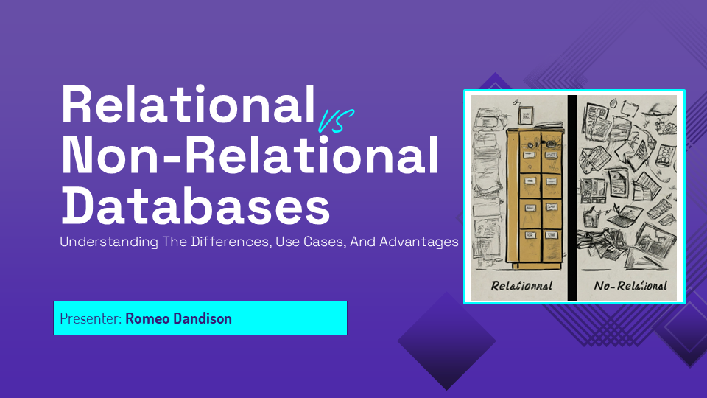
Thank you

